Slide 1

SQL –Based Customer Lifetime Value & RFM Segmentation Analysis for
Presented by Nayana Dutta

Slide 2
Project Overview
01
Analyse Customer Behaviour
02
Calculate CLV
03
Perform RFM Segmentation
04
Identify Top Products

Slide 3
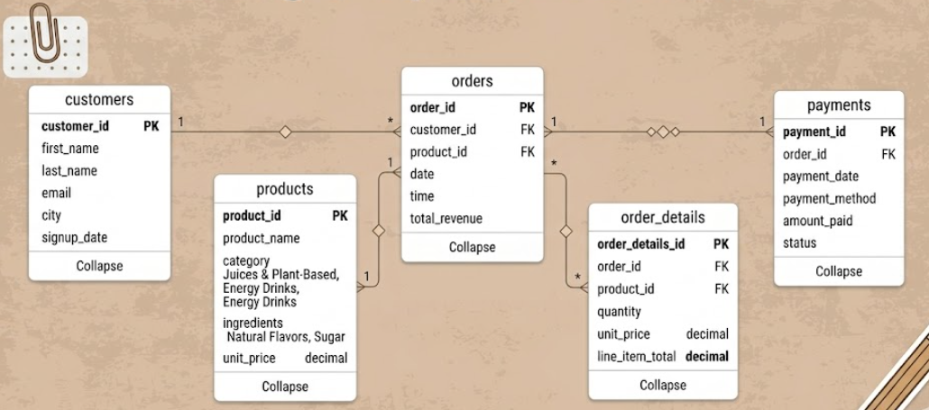

Data Schema

Slide 4
Queries Used

Slide 5
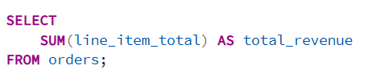
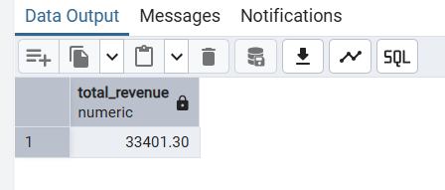
1. Coca-Cola generated strong revenue through high-frequency beverage purchases.
Query
Output

Slide 6
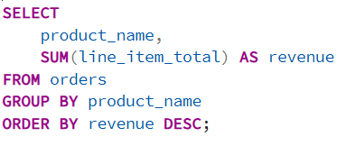
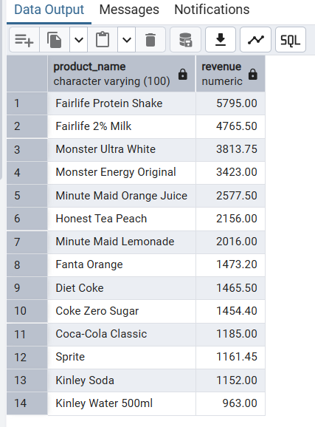
2. Coca-Cola flagship products contributed the majority of revenue.
Query
Output

Slide 7
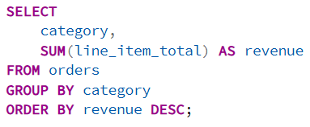
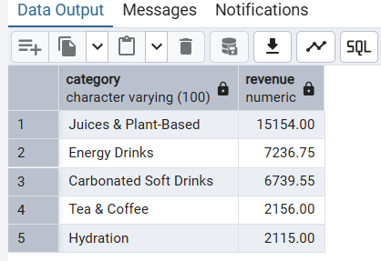
3. Juices & Plant-Based beverages generated the highest revenue, indicating a growing shift toward health-conscious beverage consumption.
Query
Output

Slide 8
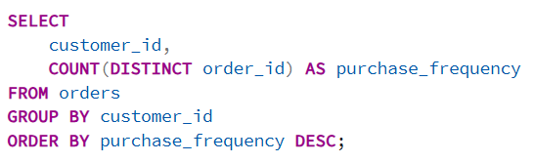
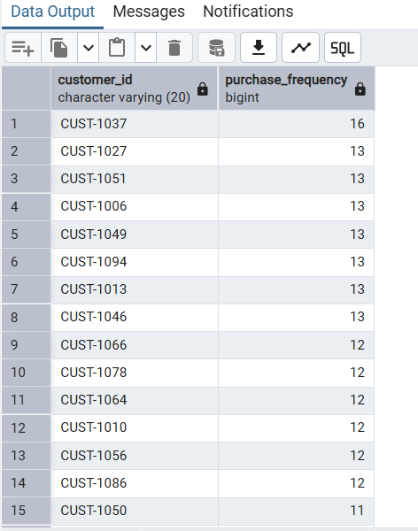
4. A small percentage of customers purchased significantly more frequently than others.
Query
Output

Slide 9
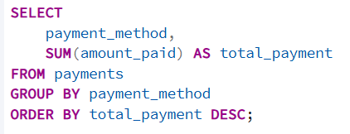
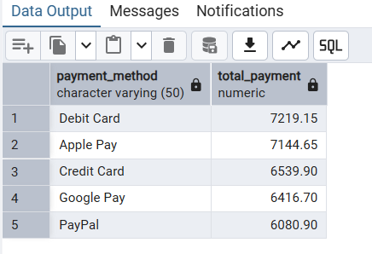
5. Debit Card and Apple Pay generated the highest transaction value, reflecting strong customer preference for digital and cashless payment methods.
Query
Output

Slide 10
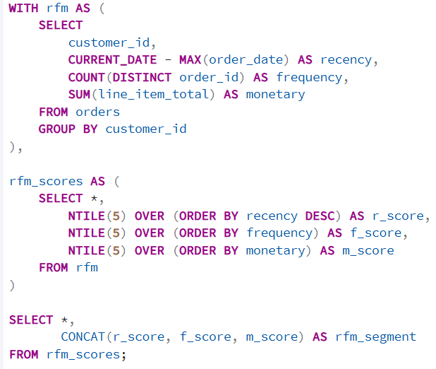
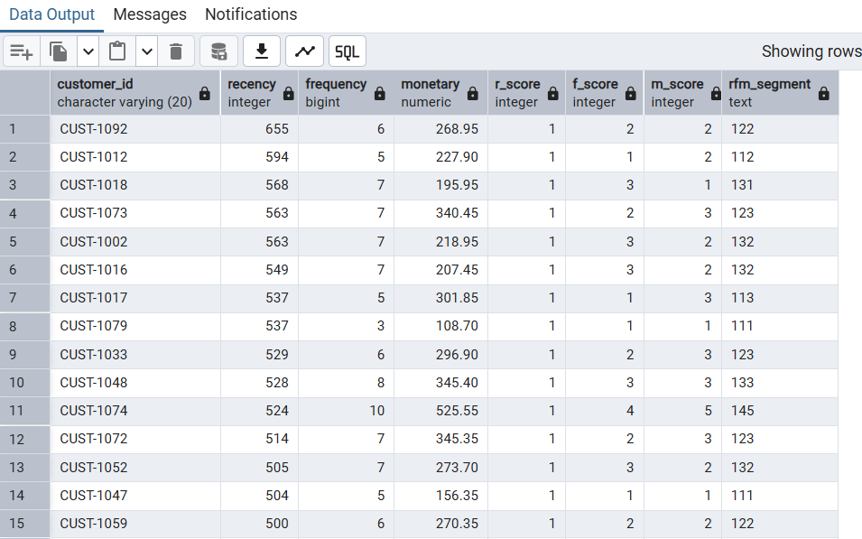
6. RFM analysis identified high-value loyal customers and potential churn customers.
Query
Output

Slide 11
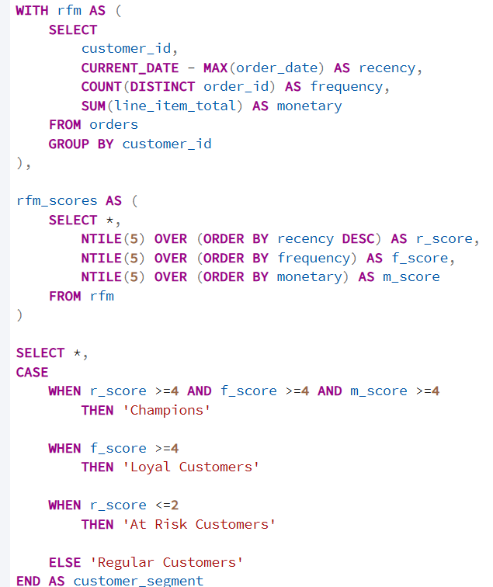
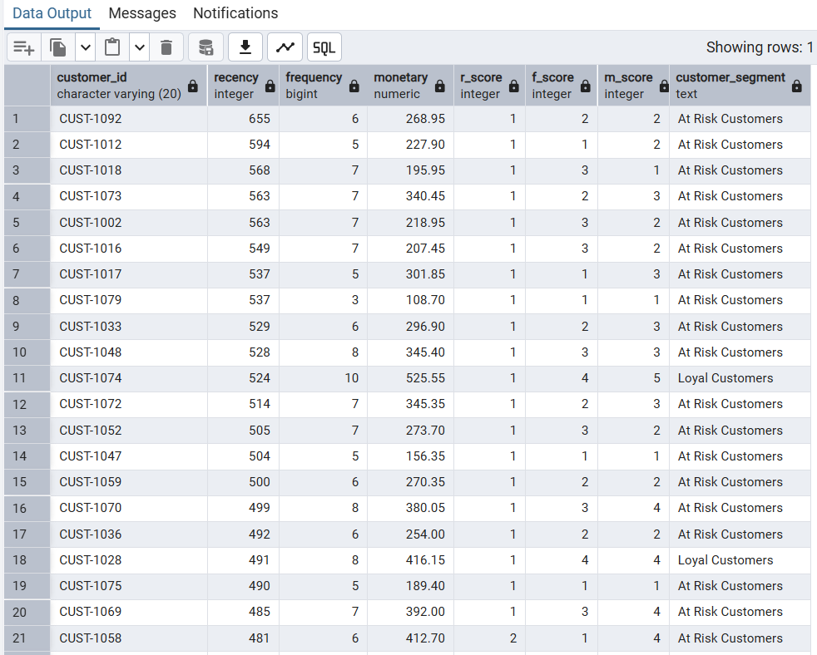
7. The segmentation analysis highlighted customer retention opportunities by identifying loyal high-frequency buyers and customers at risk of churn.
Query
Output

Slide 12
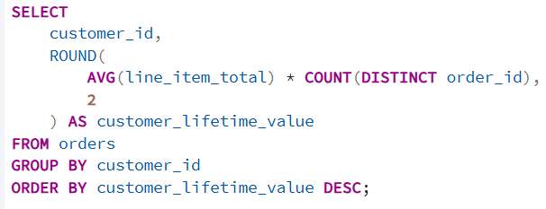
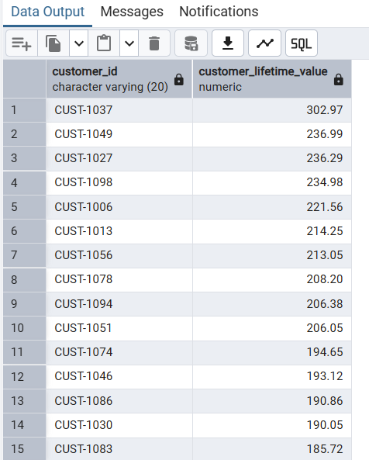
8. High CLV customers represented Coca-Cola’s most profitable consumer segment.
Query
Output

Slide 13
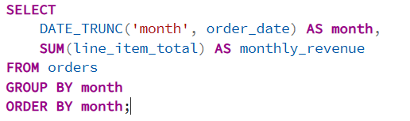
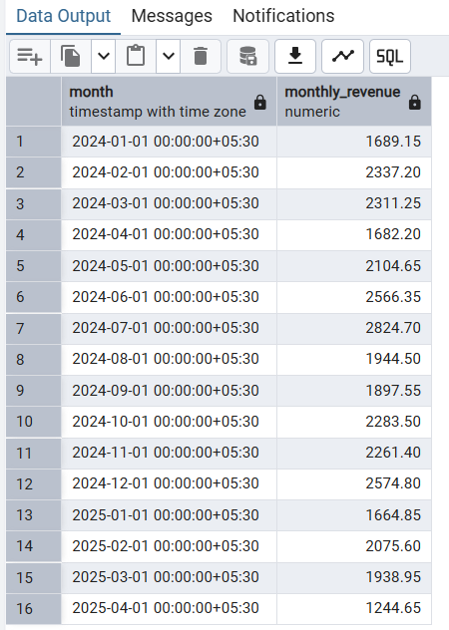
9. The monthly revenue trend analysis helped identify changing customer purchasing behavior and sales performance patterns over time.
Query
Output

Slide 14
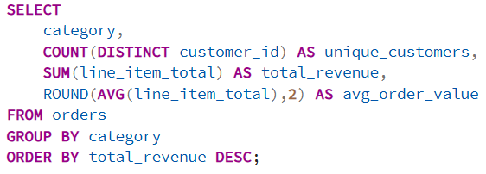
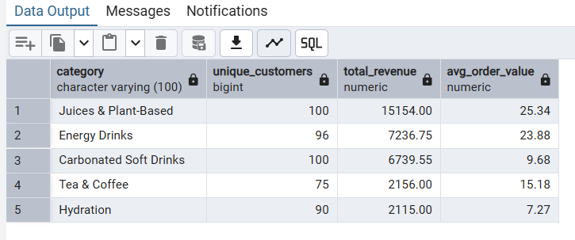
Final Insights
The SQL analysis demonstrated shifting consumer preferences toward healthier and premium beverage categories while identifying opportunities for customer retention and revenue optimization.
Query
Output

Slide 15







Conclusion
This project helped me strengthen both my technical SQL skills and my business analytical thinking by transforming transactional data into actionable customer insights.

Slide 16
Thank You

